Slide 1


E-Library
powered by
Email / SSO Id
Password
Log In

Slide 2
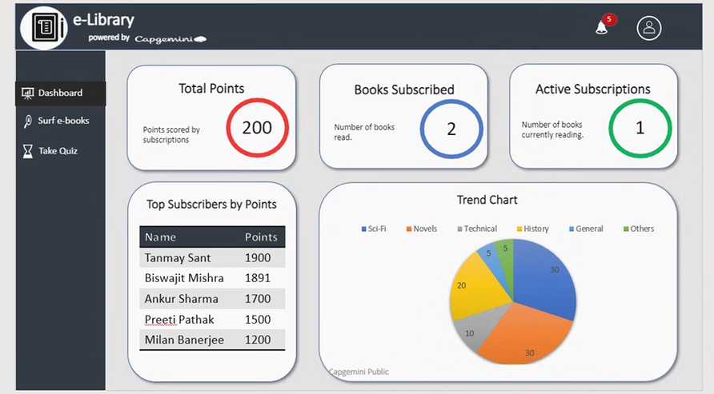

Slide 3





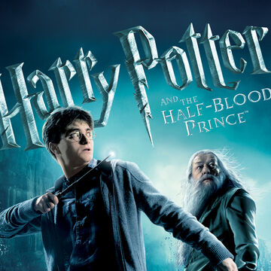

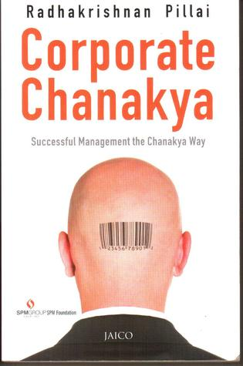
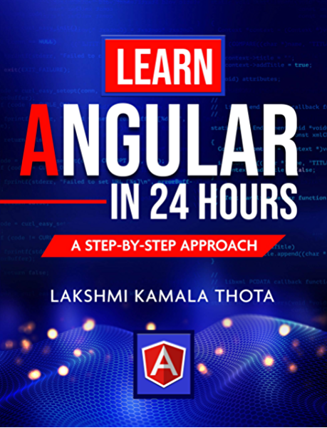
e-Library
powered by
5
Dashboard
E-Book Filters
Surf e-books
Search by Name
Search by Category
Search by Author
Filter
Take Quiz
Harry Potter & the half blood prince
Harry Potter & the prisoners of Azkaban
Harry Potter & the deathly hallows part 1
Author: J. K Rowling
Author: J. K Rowling
Author: J. K Rowling
Category: Novel
Category: Novel
Category: Novel
Preview
Preview
Preview
Subscribe now
Subscribe now
Subscribe now
Interstellar
Corporate Chanakya
Learn Angular in 24 Hrs
Author: J. K Borrow
Author: R.K Pillai
Author: L. K Thota
Category: Sci-Fi
Category: Management
Category: Technical
Preview
Preview
Preview
Subscribe now
Subscribe now
Subscribe now

Slide 4

e-Library
powered by
5
Page navigates from the preview click from surf page
Harry Potter & The Half Blood Prince (Preview)
Dashboard
Author: J. K Rowling
Harry Potter is a series of seven fantasy novels written by British author J. K. Rowling. The novels chronicle the lives of a young wizard, Harry Potter, and his friends Hermione Granger and Ron Weasley, all of whom are students at Hogwarts School of Witchcraft and Wizardry. The main story arc concerns Harry's struggle against Lord Voldemort, a dark wizard who intends to become immortal, overthrow the wizard governing body known as the Ministry of Magic and subjugate all wizards and Muggles (non-magical people).
Surf e-books
Category: Novel
Publisher: Potter More
Take Quiz
Date Published : June 26, 1997
Points : 200
Read More
Recommend to a Colleague
Opens a popup with email address field and send button.
Harry Potter & The Half Blood Prince (Plot)
The central character in the series is Harry Potter, a boy who lives in the fictional town of Little Whinging, Surrey with his aunt, uncle, and cousin – the Dursleys – and discovers at the age of eleven that he is a wizard, though he lives in the ordinary world of non-magical people known as Muggles.^{[8]} The wizarding world exists parallel to the Muggle world, albeit hidden and in secrecy. His magical ability is inborn, and children with such abilities are invited to attend exclusive magic schools that teach the necessary skills to succeed in the wizarding world.^{[9]}
Harry becomes a student at Hogwarts School of Witchcraft and Wizardry, a wizarding academy in Scotland, and it is here where most of the events in the series take place. As Harry develops through his adolescence, he learns to overcome the problems that face him: magical, social, and emotional, including ordinary teenage challenges such as friendships, infatuation, romantic relationships, schoolwork and exams, anxiety, depression, stress, and the greater test of preparing himself for the confrontation that lies ahead in wizarding Britain's increasingly-violent second wizarding war.^{[10]}
Each novel chronicles one year in Harry's life^{[11]} during the period from 1991 to 1998.^{[12]} The books also contain many flashbacks, which are frequently experienced by Harry viewing the memories of other characters in a device called a Pensieve.
The environment Rowling created is intimately connected to reality. The British magical community of the Harry Potter books is inspired by 1990s British culture.
Section Opens only when clicked on Read more and Read more text changes to collapse

Slide 5
e-Library
powered by
5
Page navigates from Active / All Subscriptions cards in dashboard
Active Subscriptions List
Dashboard
Author: J. K Rowling
Harry Potter is a series of seven fantasy novels written by British author J. K. Rowling. The novels chronicle the lives of a young wizard, Harry Potter, and his friends Hermione Granger and Ron Weasley, all of whom are students at Hogwarts School of Witchcraft and Wizardry. The main story arc concerns Harry's struggle against Lord Voldemort, a dark wizard who intends to become immortal, overthrow the wizard governing body known as the Ministry of Magic and subjugate all wizards and Muggles (non-magical people).
Surf e-books
Category: Novel
Publisher: Potter More
Take Quiz
Date Published : June 26, 1997
Points : 200
Continue Reading
Historical Subscriptions List
Section Opens only when clicked on Read more and Read more text changes to collapse

Slide 6

e-Library
powered by
5
Harry Potter & The Half Blood Prince (Subscription)
Dashboard
Author: J. K Rowling
Harry Potter is a series of seven fantasy novels written by British author J. K. Rowling. The novels chronicle the lives of a young wizard, Harry Potter, and his friends Hermione Granger and Ron Weasley, all of whom are students at Hogwarts School of Witchcraft and Wizardry. The main story arc concerns Harry's struggle against Lord Voldemort, a dark wizard who intends to become immortal, overthrow the wizard governing body known as the Ministry of Magic and subjugate all wizards and Muggles (non-magical people).
Surf e-books
Category: Novel
Publisher: Potter More
Take Quiz
Date Published : June 26, 1997
Points : 200
Subscribe
Page navigates from the Subscibe click from surf page
Harry Potter & The Half Blood Prince (Subscription Form)
Enter Global Id
Name
Debargho Bhattacharyya
Grade
C1
Joining Date
Emp Id
070620
Supervisor
Hardik Shah
Section Opens only when clicked on Subscribe.
Should open up a document editor (Not in current scope)
Save & Download

Slide 7

e-Library
powered by
5
Dashboard
Select From Your Active Subscription
e-Book Id | e-Book Name | Subscription Date | Subscription Id
1221 | Harry Potter & The Half Blood…. | 29 Mar 2020 | 1022242
1226 | Interstellar | 25 Feb 2020 | 1011231
1889 | Corporate Chanakya | 12 Jan 2020 | 1011223
Surf e-books
Take Quiz
Harry Potter & The Half Blood Prince Quiz
Question: 2 / 20
Score: 10
Who actually was the half blood prince?
A. Albus Dumbledore
B. Severus Snape
C. Bellatrix Lestrange
D. Tom Riddle
Section opens only when a subscription quiz is clicked.

Slide 8
E-Library
powered by
You have successfully Logged out, Thank You !
Go Back To Login

